Slide 1
FLOOD PLAIN ANALYSIS OF NETHRAVATHI RIVER BASIN (Using Free and Open Source Tools - QGIS and HEC-RAS)
Visvesvaraya Technological University - Belagavi
By
Mushtaq Ahmed
Lomada Sathyakiran Reddy
Pragathi Somanna P.S
Prapthi K.P
Mala R
Department of Civil Engineering
Shri Dharmasthala Manjunatheshwara Institute of Technology (SDMIT) - Ujire
Under the guidance of
Mr. VISHWANATHA BHAT

Slide 2
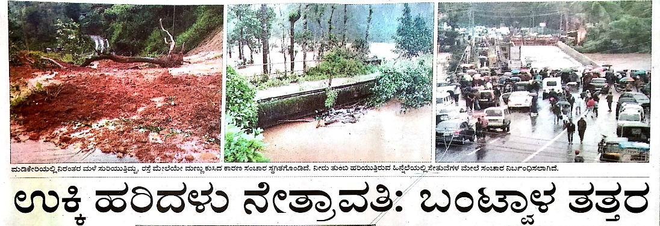
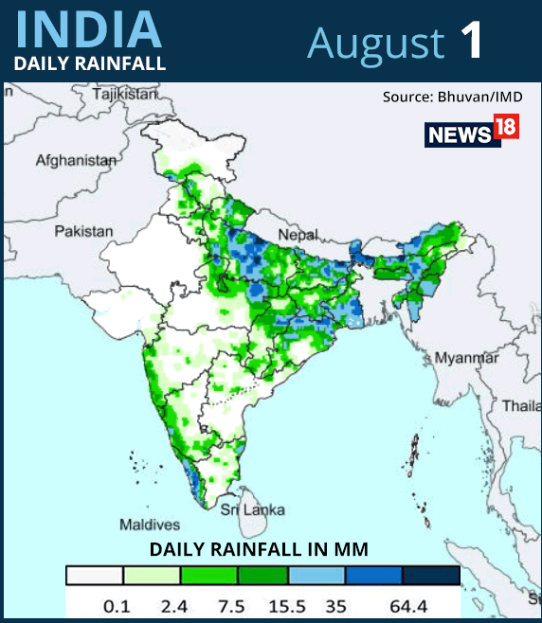
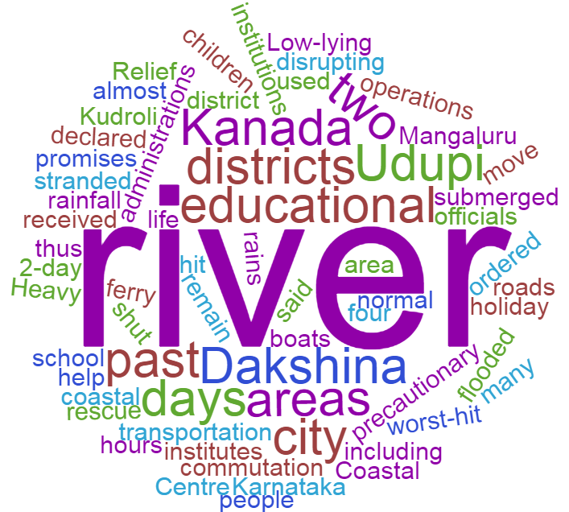
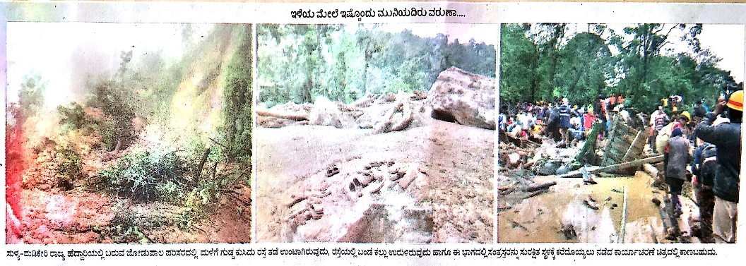
MOTIVATION
Deluge
Need of flood plain analysis and risk assessment

Slide 3

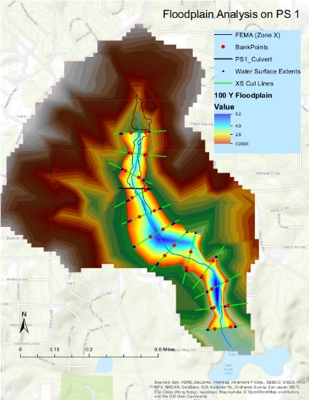
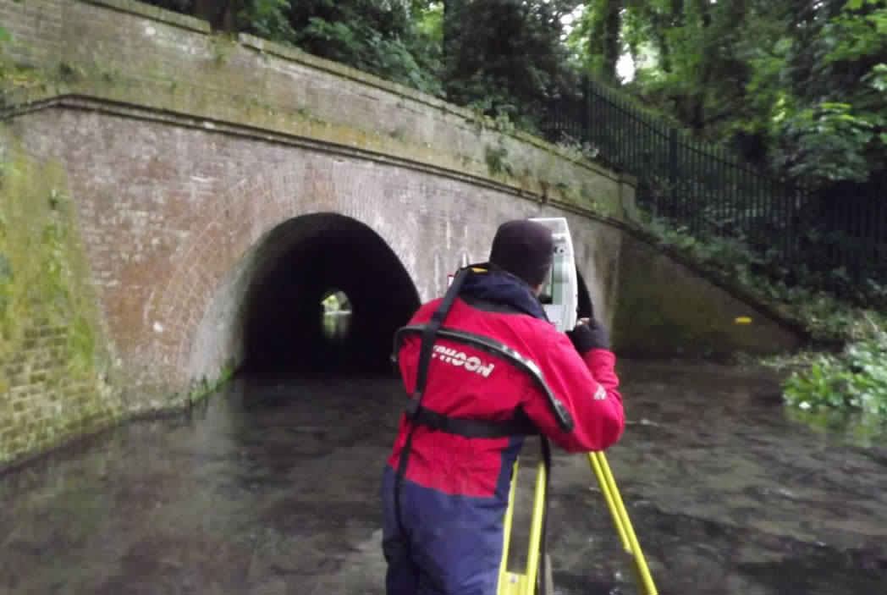
Runoff to Flood
TERMINOLOGIES
Flood- Occurs when river water inundates the land that is normally dry.
Flood plain- Flat land beside the river that regularly become flooded.
Flood plain analysis- The delineation of Flood prone areas.
Flood inundation map- Map that shows where flooding may occur in a particular stream.
Available options
Detailed survey
Remotely sensed approach

Slide 4
OBJECTIVES
The main objectives of this study are:
To estimate the probable spatial extent of the flood in prescribed region;
To perform frequency analysis for Nethravathi basin

Slide 5
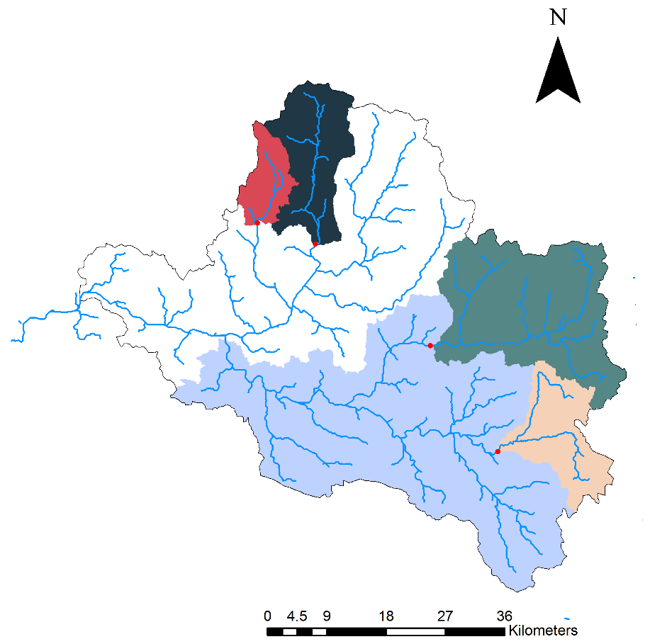
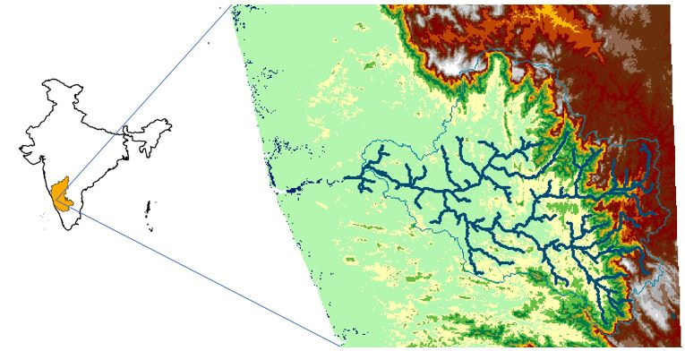
STUDY AREA
DHARMASTHALA
BELTHANGADY
UPPINANGADY
KUKKE SUBRAMANYA
KEMPUHOLE

Slide 6
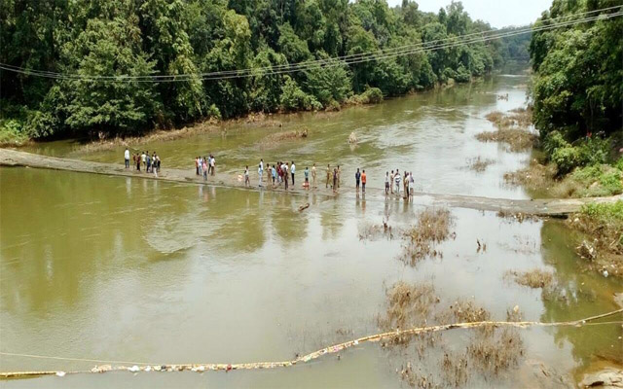
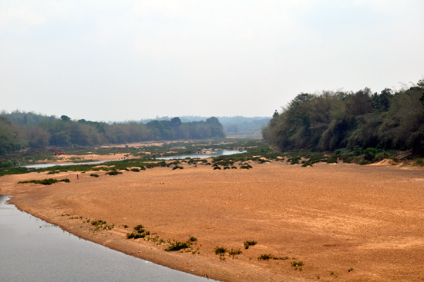
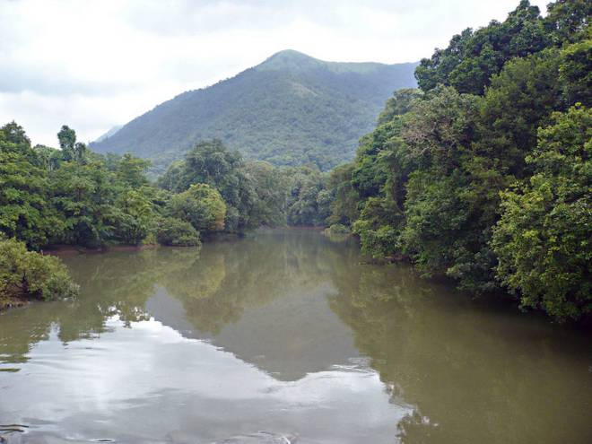
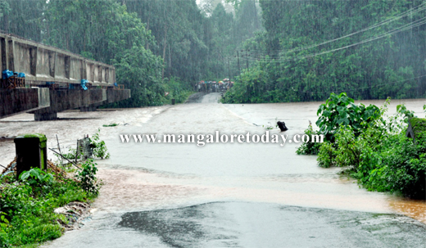
Uppinangady
Snanaghatta- Dharmasthala
Curtesy: thehindu.com
Subrahmanya
Kempuhole, Gundya

Slide 7
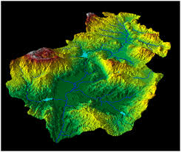
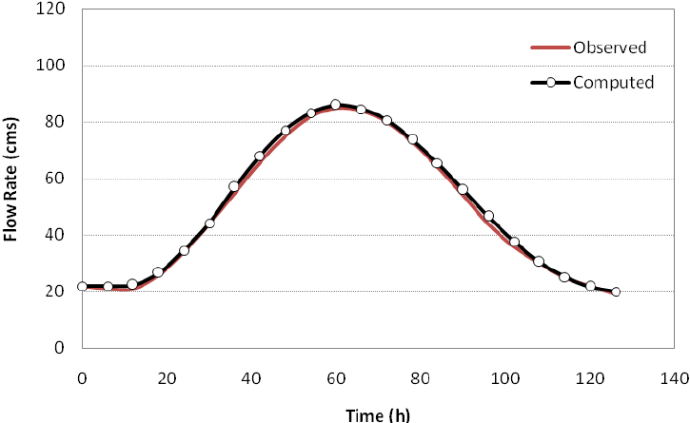
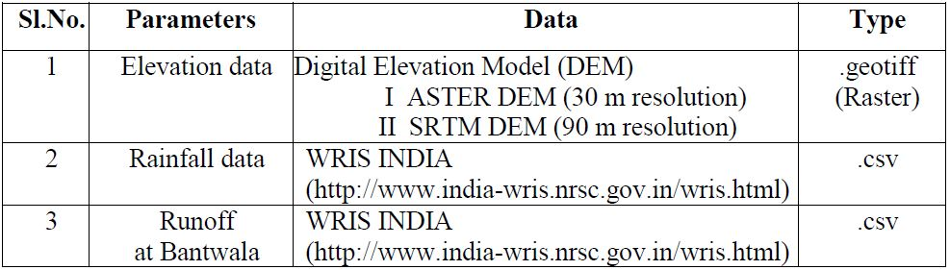
DATA
DATA
INPUT
Digital Elevation Model +
Runoff Data

Slide 8

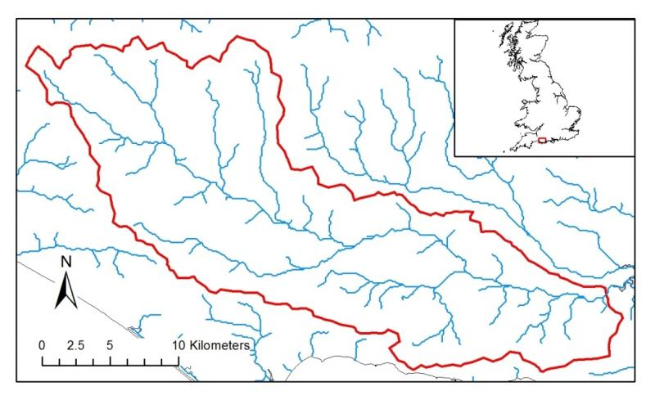

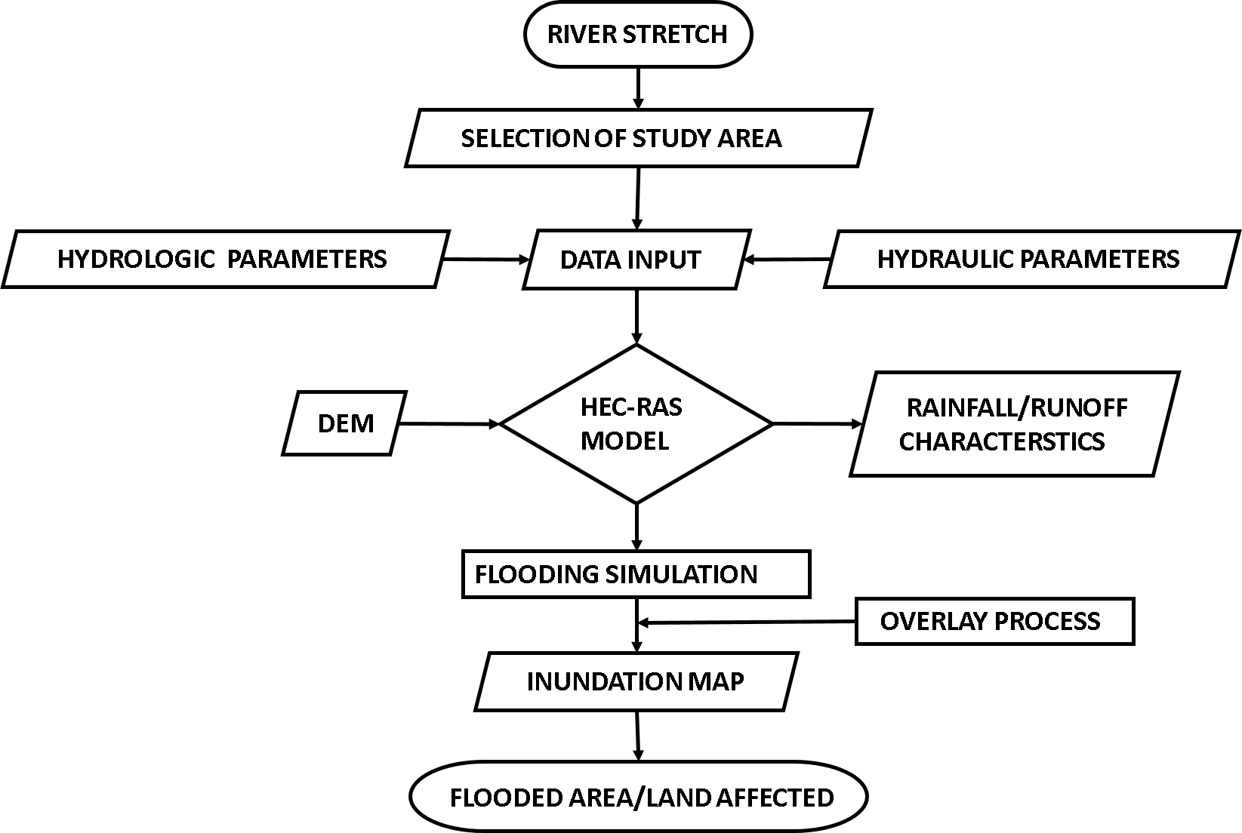
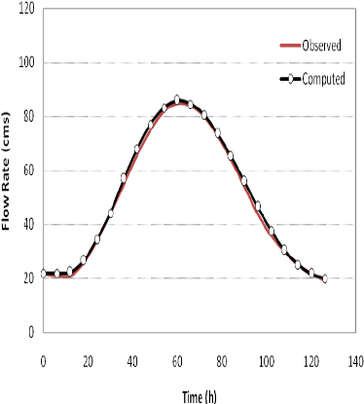
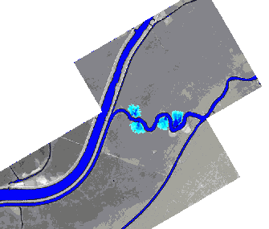
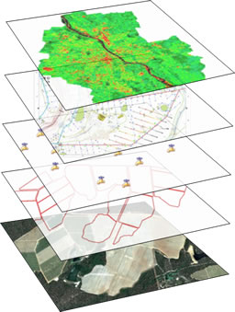
DETAILED METHODOLOGY
PRE-PROCESSING

Slide 9
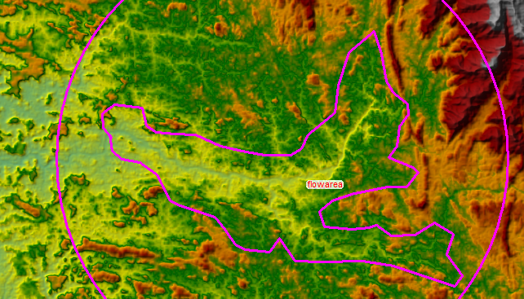

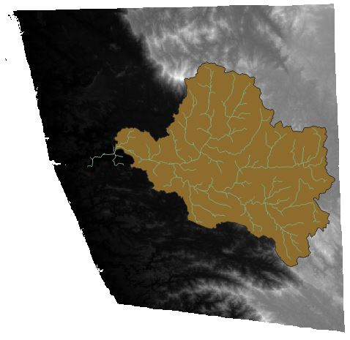
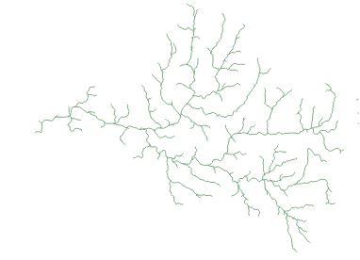
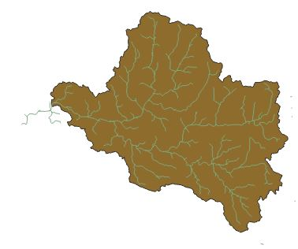
Free and Open Source Tools
HEC – RAS: Hydrologic Engineering Center –River Analysis System (HEC-RAS)-US Army Corps of Engineers (USACE), modelling of open channel flow.
Quantum Geographic Information System is a software used for processing, geo-referencing, delineation of streams and areas, in raster and vector models.

Slide 10
RESULTS
Peak Flood Analysis
Years | Seasonal Sum
2000 | 103039.484
2001 | 94202.368
2002 | 70180.231
2003 | 86327.086
2004 | 98838.756
2005 | 135199.097
2006 | 151882.668
2007 | 160412.28
2008 | 165873.349
2009 | 132960.797
2010 | 120686.028
2011 | 130664.112
2012 | 99947.817
2014 | 121038.65
2015 | 58417.964
2016 | 64703.438
Data: WRIS

Slide 12
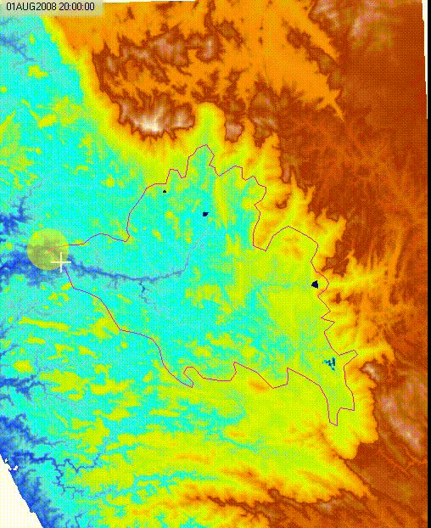
They say beyond simulation….
STUDY REGION | SPATIAL EXTENT (km²) | DEPTH (m)
Dharmasthala | 1.364 | 132.44
Belthangady | 0.7966 | 351.7
Kempuhole | 4.116 | 655.34
Kukke Subramanya | 7.180 | 12.2
Uppinangady | 6.549 | 71.17

Slide 13
Conclusions
Flood analyzed for this study pertains the return period of 1 in 185 years;
The landmass under inundation for the up-land and low-land areas of Nethravathi Basin varies with elevation;
The low and mid altitude regions of the catchment are more prone to inundation such as the one observed at the locations of Kukke Subrahmanya and confluence of Uppinangady;
Areal spread of flood is more in low lands compared with the uplands;
Upland stretches of river valleys are more steep and hence, offer high depth within the valley for flood flow.

Slide 14
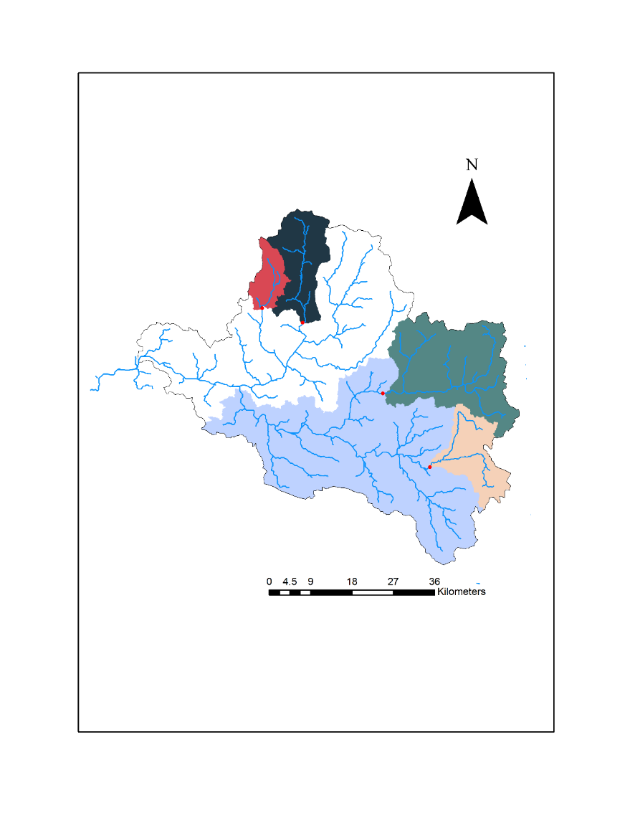
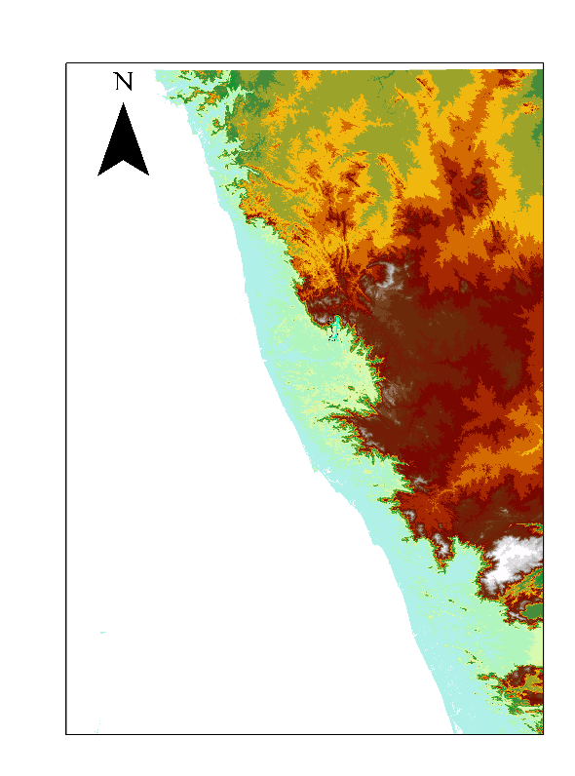
To Summarise…
GIS Interface
HecRAS

Slide 15
References
National Disaster Management Authority Government of India,2008, “National Disaster Management Guidelines”, 1-10
R.K. Bhansal, 2002, “ Fluid mechanics and hydraulic machines”, 204-250;
Goodell; Warren, 2006 Obras Y Proyectos : “Flood inundation mapping using HEC-RAS”., 39, 2198–2208;
H.de Moel, J.Van Alphen, J.C.J.H.Aerts, 2009 Natural Hazards and Earth System Science “Flood mapping Europe- methods, availability, and use”, 11.3.4, p. 109.;
https://timesofindia.indiatimes.com/city/bengaluru/heavy-rain-continues-to-lash-karnataka-district/articleshow/65452352.cms;
https://economictimes.indiatimes.com/news/politics-and-nation/karnataka-floods-heavy-rains-wreak-havoc-in-5-districts/videoshow/65444251;

